Slide 1
CMSC201 Computer Science I for Majors Lecture 05 – Algorithmic Thinking

Slide 2
Last Class We Covered
Decision structures
One-way (using if)
Two-way (using if and else)
Multi-way (using if, elif, and else)
Nested decision structures

Slide 3
Any Questions from Last Time?

Slide 4
Today’s Objectives
To practice thinking algorithmically
To understand and be able to implement proper program development
To learn more about “bugs”
To get practice with decision structures
(Lots of practice)

Slide 5
What is an Algorithm?
Steps used to solve a problem
Problem must be
Well defined
Fully understood by the programmer
Steps must be
Ordered
Clear
Complete

Slide 6
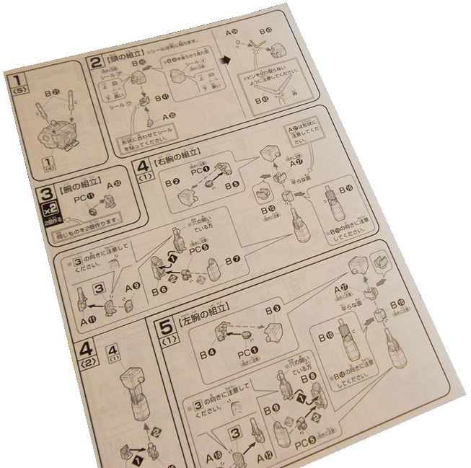
Algorithmic Thinking
Algorithms are an ordered set of clear steps that fully describes a process
Examples from real life?
Recipes
Driving directions
Instruction manual (IKEA)
(maybe not so much)
???

Slide 7
Developing an Algorithm

Slide 8
Program Development
Understand the problem
Represent your solution (your algorithm)
Pseudocode
Flowchart
Implement the algorithm in a program
Test and debug your program

Slide 9
Step 1: Understanding the Problem
Input
What information or data are you given?
Process
What must you do with the information/data?
This is your algorithm!
Output
What are your deliverables?

Slide 10
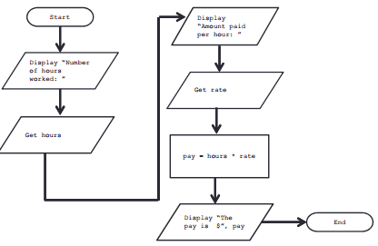
Step 2: Represent the Algorithm
Can be done with flowchart or pseudocode
Flowchart
Symbols convey different types of actions
Pseudocode
A cross between code and plain English
One may be easier for you – use that one

Slide 11
Steps 3 and 4: Implementation and Testing/Debugging
Implementing and testing/debugging your program are two steps that go hand in hand
After implementing, you must test it
After discovering errors, you must find them
Once found, you must fix them
Once found and fixed, you must test again

Slide 12
Development Example: Weekly Pay
Create a program to calculate the weekly pay of an hourly employee
What is the input, process, and output?
Input: pay rate and number of hours
Process: multiply pay rate by number of hours
Output: weekly pay

Slide 13
Flowchart Symbols
Start
Start Symbol
Input/Output
End
End Symbol
Decision Symbol
Data Processing Symbol
Flow Control Arrows

Slide 14
Step 2A: Flowchart
Start
Get the rate
Display “Number of hours worked: ”
pay = hours * rate
Get the hours
Display “The pay is $” , pay
Display “Amount paid per hour: ”
End

Slide 15
Step 2B: Pseudocode
Start with a plain English description, then…
Display "Number of hours worked: "
Get the hours
Display "Amount paid per hour: "
Get the rate
Compute pay = hours * rate
Display "The pay is $" , pay

Slide 16
Algorithms and Language
Notice that developing the algorithm didn’t involve any Python at all
Only pseudocode or a flowchart was needed
An algorithm can be coded up in any language
All languages share certain tools that can be used in your algorithms
For example, control structures and expressions

Slide 17
Exercise: Are Dogs Good?
Ask the user if a dog is a good dog
Print out one response for “yes”
Print out a different response for any other answer

Slide 18
Debugging

Slide 19
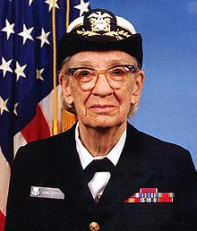
A Bit of History on “Bugs”
US Navy lab (Sep 1947)
Grace Hopper and her colleagues were working on the Harvard Mark II
Instructions read one at a time from a tape
Or trying to… it wasn’t working right
Rear Admiral Grace Hopper

Slide 20
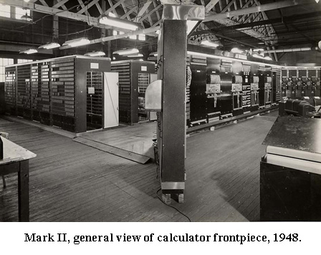
A Bit of History on “Bugs”
Mark II was a LARGE machine that took up an entire room
You could open each panel and look inside
They found a moth inside the machine
Taped the bug into their log book

Slide 21
Errors (“Bugs”)
Two main classifications of errors
Syntax errors
Prevent Python from understanding what to do
Logical errors
Cause the program to run incorrectly, or to not do what you want

Slide 22
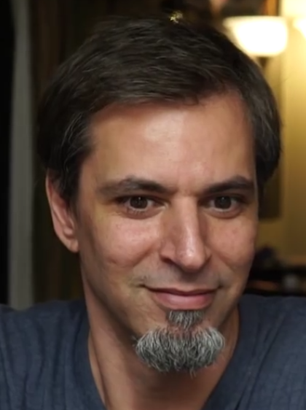
PB&J Using Exact Instructions
“You’re not even making any sense! He’s already ruined it on purpose, he knows how to make one.”
Watch the video here
(Image from Josh Darnit’s Exact Instructions Challenge)
Notes:
Watch from 0:37 until about 5:34

Slide 23
Syntax Errors
“Syntax” is the set of rules followed by a computer programming language
Similar to grammar and spelling in English
Examples of Python’s syntax rules:
Keywords must be spelled correctly
True and False, not Ture or Flase or Truu
Quotes and parentheses must be closed in order:
("open and close")

Slide 24
Syntax Error Examples
Find the syntax errors in each line of code below:
1 prnit("Hello")
2 print("What"s up?")
3 print("Aloha!)
4 print("Good Monring")

Slide 25
Syntax Error Examples
Find the syntax errors in each line of code below:
1 prnit("Hello")
2 print("What"s up?")
3 print("Aloha!)
4 print("Good Monring")
not actually a syntax error

Slide 26
Syntax Error Examples
Find the syntax errors in each line of code below:
1 prnit("Hello")
2 print("What"s up?")
3 print("Aloha!)
4 print("Good Monring")
The syntax highlighting in emacs can often help you see where the errors are

Slide 27
Logical Errors
Logical errors don’t bother Python at all… they only bother you!
Examples of logical errors:
Using the wrong value for something
currentYear = 2013
Doing steps in the wrong order
“Place pan in the oven. Preheat oven to 350. Pour batter into pan, spreading evenly.”

Slide 28
Comments in Debugging
Comments should be used to convey what your program is accomplishing
If there is a bug, however, your code may not actually be accomplishing that task
Comments are very useful when debugging, because they separate intent from actuality
“Is your code working?” and “Is your code doing what it’s supposed to do?” are very different questions

Slide 29
Practicing Decision Structures

Slide 30
Exercise: Twitter Followers
Prof. Neary has a quite a few Twitter followers
Write a game where the user guesses how many followers he has, and tell them whether their guess was high, low, or correct
What info do you need?
(He has 380 followers)

Slide 31
Exercise: Moving on to CMSC 202
Ask the user their major and the grade they earned in CMSC 201
Print out whether they can move on to CMSC 202 next semester
If they’re a CMSC or CMPE major
They need an A or a B
Otherwise
They need an A, B, or a C

Slide 32
Daily emacs Shortcut
CTRL+S
Allows you to search within a file
(To remember: S stands for “search”)
Hit CTRL+S, then type in what you want to find
Hit CTRL+S again to find the next occurrence
If you reach the end of the file and want to start back at the beginning, hit CTRL+S again
Use any movement (arrows, etc.) to exit

Slide 33
Announcements
HW 2 is out on Blackboard now
Must complete the Academic Integrity Quiz to view it, and score a 12 / 12
Due by Saturday (September 22nd) at 8:59:59 PM
Course Schedule is on the website
Midterm #1 is in class on October 3rd and 4th
SDS students, schedule your exam ASAP (for either day)
Notify Prof. Neary by September 26th with details

Slide 34
Image Sources
IKEA instructions (adapted from):
https://www.flickr.com/photos/girlinblack/6697086037
Three dogs:
https://pixabay.com/p-984015/
Rear Admiral Grace Hopper:
https://commons.wikimedia.org/wiki/File:Grace_Hopper.jpg
Mark II:
http://amhistory.si.edu/archives/images/d8324-1.jpg
Notebook bug (adapted from):
https://commons.wikimedia.org/wiki/File:H96566k.jpg
Computer bug:
https://pixabay.com/p-1296767/
Twitter logo
https://pixabay.com/en/p-312464/
Question mark man:
https://pixabay.com/p-1019993/

